Slide 1
Long E Sound
Vowel Teams EA, EE, Ey

Slide 2
Vowel Teams EA, EE, and EY
When you see two vowels together like EA, EE, or EY, they make one sound and that sound is the long E sound.
We see and hear the long e in words like
Feet
Treat
monkey

Slide 3
Practice Together
On the next three slides we will practice saying words together that have our long e vowel teams in them.

Slide 4
Treat

Slide 5
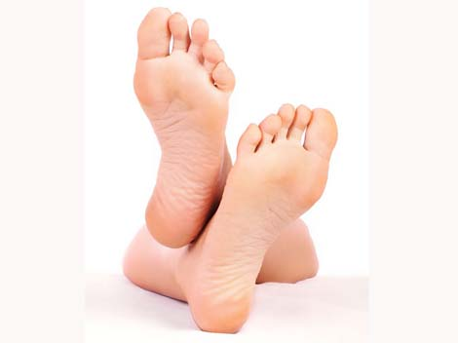
Feet

Slide 6
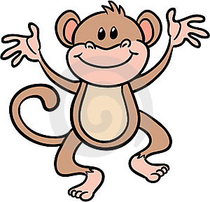
Monkey

Slide 7
The vowel team ea is at the beginning of words.
ea at the beginning
each
East
eat
Can you think of other words that have the vowel team ea at the beginning of the word and write them down? I think you can

Slide 8
The vowel team ea is at the middle of words.
ea at the middle
treat
seat
please
Can you think of other words that have the vowel team ea at the middle of the word and write them down? I think you can

Slide 9
The vowel team ea is at the end of words.
ea at the end
flea
sea
pea
Can you think of other words that have the vowel team ea at the end of the word and write them down? I think you can

Slide 10
The vowel team ee is at the middle of words.
ee at the middle
feet
sweet
greet
Can you think of other words that have the vowel team ee at the middle of the word and write them down? I think you can

Slide 11
The vowel team ee is at the end of words
ee at the end
bee
tree
see
Can you think of other words that have the vowel team ee at the end of the word and write them down? I think you can

Slide 12
The vowel team ey is at the end of words
monkey
money
chimney
Can you think of other words that have the vowel team ee at the end of the word and write them down? I think you can

Slide 13
Let’s watch some videos on vowel teams
Watch these videos by clicking on the link below.
https://www.youtube.com/watch?v=ItwLPmWxYco
https://www.youtube.com/watch?v=rn_N-h3mvc8

Slide 14
Practice your skills with long e vowel teams
Your teacher will have activities to work on for the week to help you continue learning about the long e vowel teams. When you do the activities you can take pictures and post them to your ELD teacher’s Class Dojo or to your ELD teacher’s email, which can be found on their websites.
If you have any questions we are here to help. Contact us through email or through Class Dojo.
Have Fun Learning. We miss you!

